Slide 1

Motion Control of a 4-DOF
Cable-Driven Upper Limb Exoskeleton
Jianhua Wang, Wang Li, Weihai Chen, &Jianbin Zhnag
School of Automation Science and Electrical Engineering
Beihang University
China

Slide 2
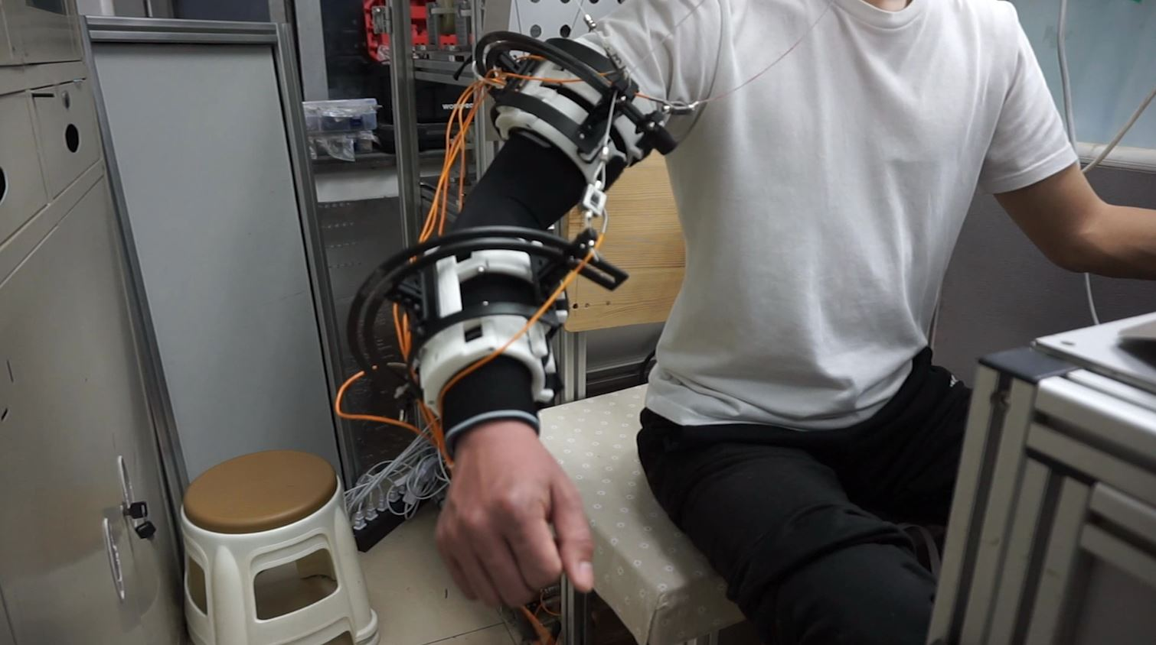
Introduction
4-DOF cable-driven upper limb exoskeleton
Shoulder module and elbow can be analyzed separately.
PD feedback combined with inverse dynamic feedforward controller
Optimal cable tension

Slide 3
Outline
Background
Kinematic and dynamic modeling
Control scheme and hardware
Experiment result
Conclusion and future work

Slide 4
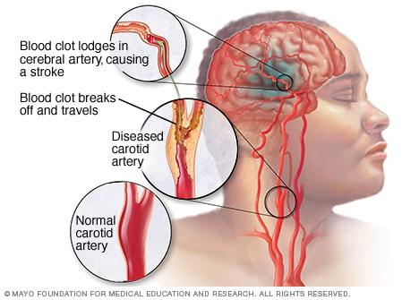
Background
STROKE:
The second most common cause of death and disability worldwide.
When the blood supply to part of your brain is interrupted or reduced.
The burden will increase greatly during the next 20 years, especially in developing countries.
Strokes can be treated and prevented.

Slide 5

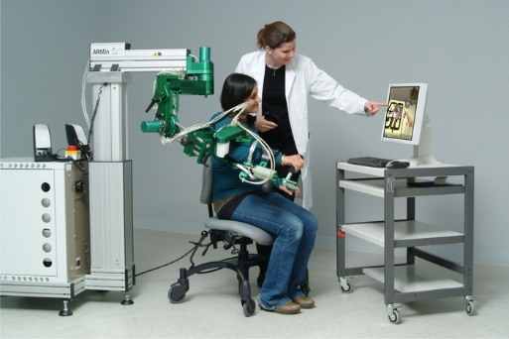
Background
Traditional therapies:
Physical therapist
Low efficiency
Rehabilitation robot:
Controlled and repeatable motions
Availability of measurements

Slide 6
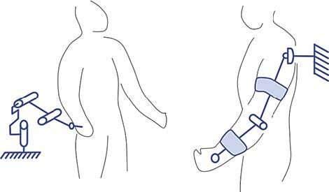
Background
Classification
End-effector-based
Exoskeleton

Slide 7
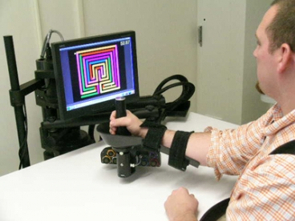
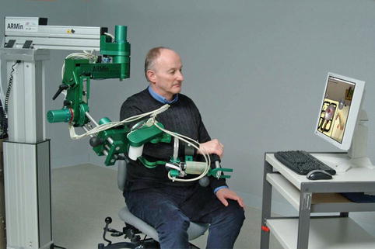
Background
Classification
End-effector-based
MIT-MANUS
InMotion ARM™
Exoskeleton
ARM-Guide
ARMin

Slide 8
Outline
Background
Kinematic and dynamic modeling
Control scheme and hardware
Experiment result
Conclusion and future work

Slide 9
Anatomy of upper limb
Segments:
Upper arm
Forearm
Hand
Joints:
Shoulder
Elbow
wrist

Slide 10
Mechanical structure
Exoskeleton:
4-DOF(3-DOF of shoulder module & 1-DOF of elbow module).
Cable-driven.
Advantages:
Lighter
Cable nodes are flexible.
Shoulder module and elbow can be analyzed separately.
Without the need for joint alignment.

Slide 11
Kinematic and dynamic modeling
Kinematic model:
Dynamic model:

Slide 12
Outline
Background
Kinematic and dynamic modeling
Control scheme and hardware
Experiment result
Conclusion and future work

Slide 13
Control scheme
Control law:

Slide 14
Tension distribution
Redundancy of actuation
Quadratic programming
Notes:
Cable-driven exoskeleton robot include two joint with redundance actuation, shoulder joint module and elbow joint

Slide 15
Hardware
Main components:
Six motors and motor drivers
Two IMU and six load sensors
Two acquisition card
IPC

Slide 16
Outline
Background
Kinematic and dynamic modeling
Control scheme and hardware
Experiment result
Conclusion and future work

Slide 17
Experiment video

Slide 18
Experiment Result
Planned
Measured
Trajectory:
Joint space
Cubic polynomial interpolation
Four degree respectively
10
10
0
0
q1( °)
-10
q2( °)
-10
-20
-20
-30
-30
-40
-40
8 10
time(s)
18
-50
8 10
time(s)
14
18
0
2
4
6
12
14
16
0
2
4
6
12
16
30
0
20
-5
q3( °)
10
q4( °)
-10
-15
0
-20
-10
-25
-20
-30
-35
-30
8 10
time(s)
12
14
16
18
-40
8 10
time(s)
12
14
16
18
0
2
4
6
0
2
4
6

Slide 19
Outline
Background
Kinematic and dynamic modeling
Control scheme and hardware
Experiment result
Conclusion and future work

Slide 20
Conclusion and future work
Conclusion:
Propose 4-DOF cable-driven exoskeleton
PD feedback combined with inverse dynamic feedforward controller
Optimize cable tension
Works well in prototype exoskeleton
Future work:
Experiment on patients to verify its effectiveness

Slide 21
Thank you!
Questions?

